Slide 1
Event-driven system: model-driven development using round-trip engineering method

Slide 2
Event-driven system and model-driven development
System architecture is described by using class/component dia
Class/component’s dynamic behavior: state machine (full features)
Software architects: prefer using graphic-based languages
Programmers: effectively + efficiently with textual languages + favourite IDE
Collaboration raises the synchronization issues: round-trip engineering

Slide 3
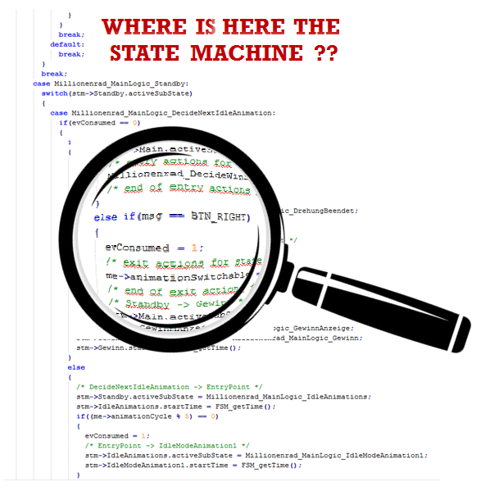
Event-driven system: model-driven development using round-trip engineering method
Current round-trip engineering:
Support only static concepts available in class diagram
For dynamic behaviors: some advanced tools (IBM Rhapsody) allow to synchronize user code, which is written either in a restrictive editor or in IDEs but the programmers are forbidden to modify the behavior part, thus have no control on the high-level dynamic behavior without an appropriate supporting tool.
“A common problem in Round-Trip-Engineering tools is that the model reversed is not the same as the original one, unless the tools are helped by laborious annotations. The behavioral parts of UML (e.g. state machine) impose even more challenges for RTE" en.wikipedia.org

Slide 4
Event-driven system: model-driven development using round-trip engineering method
Goal
Provides a method which allows software architects and programmers to freely modify the model and code, respectively
A methodology to synchronize these artifacts in case of concurrent modifications made by the stakeholders
Idea
Inspired by [Jonathan]: connecting software architecture to implementation
Extends a pratical implementation language (e.g. C++) to incorporate state machine features (e.g. state, event, transition)
[Jonathan]Jonathan Aldrich, Craig Chambers, and David Notkin. 2002. ArchJava: connecting software architecture to implementation.
In Proceedings of the 24th International Conference on Software Engineering (ICSE '02).
ACM, New York, NY, USA, 187-197. DOI=http://dx.doi.org/10.1145/581339.581365

Slide 5

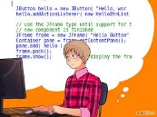
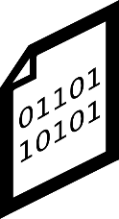
Round-trip engineering method
Software Architect
Programmer
-Structure changes
-Behavior changes
-User code changes
-Algorithm code
Modify
Modify
UML Model
Code
generation
Code
Code
compilaton
-Current method (existing methods)
-Our method
Invisible to stakeholders
-Structure changes
-Behavior changes
-User code changes
-Behavior changes
-Algorithm code
UML Model
Model-front-end
sync
Front-end Code
Back-end
generation
Back-end Code
Code
compilaton

Slide 6
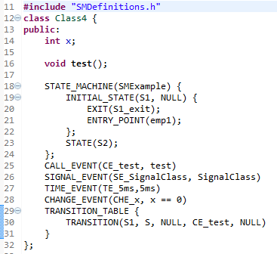
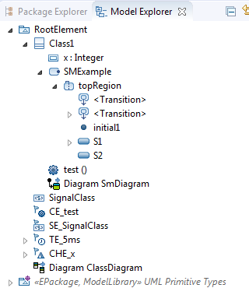
Round-trip engineering method
Clear separation of State Machine with other parts within a class
Class
Structural part
State machine part
Usual operation part

Slide 7
Round-trip use-cases and scenarios
Software Architect Side
Programmer Side
Legacy code
Initialization step
1
Reverse to new model + validation
Model
2
Front-end
Code generation
Front-end code
5
Back-end
Code generation
Back-end code
3
Modification
(Manual) Validation is needed because we use some patterns to transform pure C code (not C++) to an object-oriented model (e.g. file scope functions, extern variables)
4
Reverse (Overwrite)
Modified front-end code
Scenario 1: only front-end code is modified

Slide 8
Round-trip use-cases and scenarios
Software Architect Side
Programmer Side
Initialization step
Legacy code
1
Reverse to new model + validation
Model
2
Front-end
Code generation
Front-end code
5
Back-end
Code generation
Back-end code
3
Modification
4
Front-end
Code generation
Modified model
Scenario 2: only model is modified

Slide 9
Round-trip use-cases and scenarios
Software Architect Side
Programmer Side
Legacy code
Initialization step
1
Reverse to new model + validation
Model
Code generation
Front-end code
2
Several strategies are possible. We propose one based on comparing manually modified code with an representation of the model as code, called “image of model”
Synchronized back-end code
3
Modification
3
Modification
Modified model
Modified front-end code
4
Synhronization
5
Back-end
Code generation
Synchronized model
Synchronized modified front-end code
Scenario 3: model and code are both modified

Slide 10
Round-trip engineering: Front-end design
-Structure changes
-Behavior changes
-User code changes
-Behavior changes
UML Model
Model-front-end
sync
Front-end Code
Back-end
generation
Back-end Code
Code
compilaton
Two ways:
Front-end as a separate language, which defines the state machine textually (as Umple) (Front-end 1)
Front-end as new constructs extending a programming language, adding more features to connect the programming language to the actual behavior model (Front-end 2)

Slide 11
Round-trip engineering: Front-end 1
-Structure changes
-Behavior changes
-User code changes
-Behavior changes
UML Model
Model-front-end
sync
Front-end Code
Back-end
generation
Back-end Code
Code
compilaton
Front-end code (Umple-like): Mixing C++ and the state machine description (SMDes)
State machine description = State machine structure + event definition + transition table
SMDes is written in a simple syntax, can be written either in the owning active class or in a separate file
Programmers have full control to modify the UML-compliant state machine textually while fully profit advantages of favourite IDEs
Back-end code: actual code, including generated code + user code, is ready for compilation
Invisible to programmers and architects

Slide 12
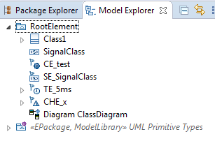
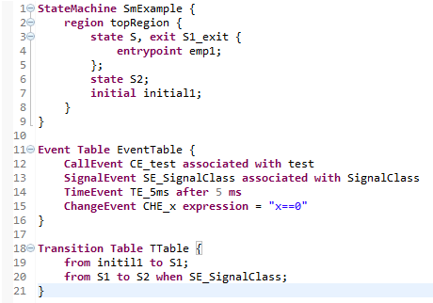
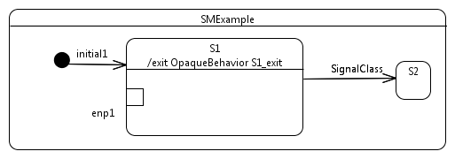
Round-trip engineering: Front-end 1
State machine description
Region name
Machine name
State exit action: implemented in the owning active class
State name
entrypoint
Initial pseudo
Events
Transitions
Source
Target
Triggering Event

Slide 13
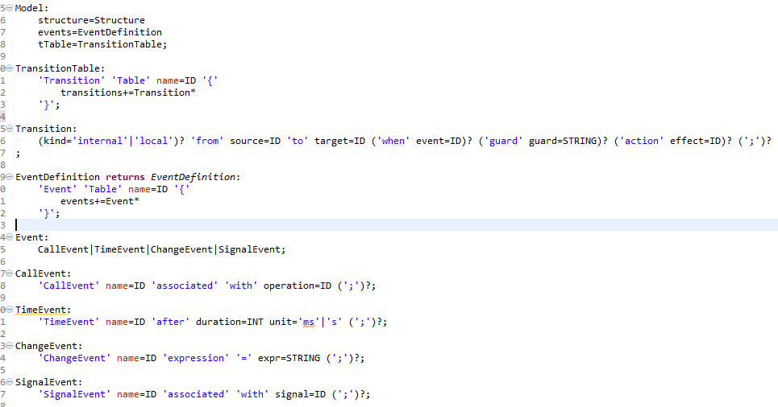
Round-trip engineering: Front-end 1
State machine description syntax

Slide 14
Round-trip engineering: Front-end 2: Connecting UML State Machine to C++
-Structure changes
-Behavior changes
-User code changes
-Behavior changes
Front-end synchronizer
Back-end code generator
UML Model
Model-front-end
sync
Front-end Code
Back-end
generation
Back-end Code
Code
compilaton
Front-end code: C++ with additional constructs to connect to built-in state machine features
State machine description = State machine structure + event definition + transition table
SMDes is written and specifified by additional C++ constructs, e.g. STATE, CALL_EVENT
Programmers are freely to work with favourite IDEs, not constrained as in Umple
Syntax should be simple and easy to use
Programmers have full control to modify the UML-compliant state machine textually while fully profit advantages of favourite IDEs
Back-end code: actual code, including generated code + user code, is ready for compilation
Invisible to programmers and architects
An additional code generator: from front-end to back-end code

Slide 15
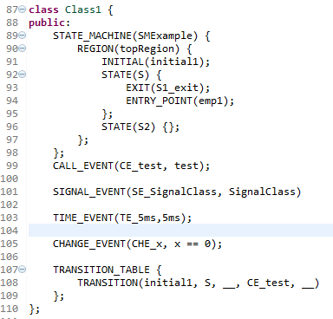
Round-trip engineering: Front-end 2: Connecting UML State Machine to C++
State machine description (with built-in state machine constructs using C++ macros)
Region name
Machine name
Initial pseudo
State name
State exit action: implemented in the owning active class
entrypoint
Events
Transitions
Source
Target

Slide 16
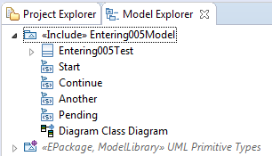
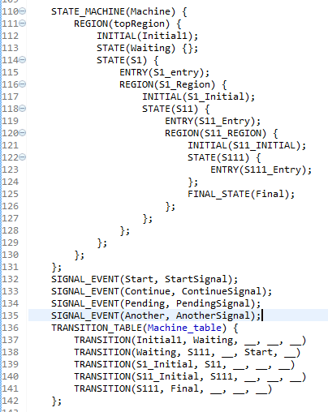
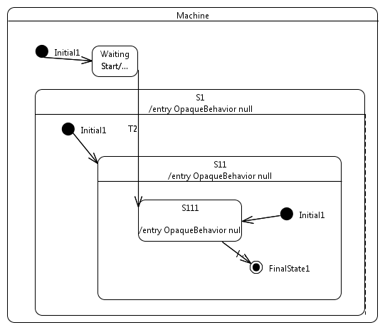
Round-trip engineering: Front-end 2: Connecting UML State Machine to C++
This is defined inside of C++ class declaration (as a member of the C++ class)
State machine description

Slide 17
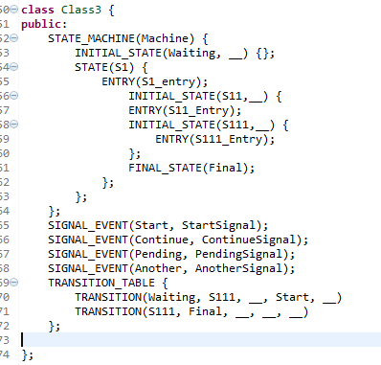
Round-trip engineering: Front-end 2: Connecting UML State Machine to C++
State machine description
This is defined inside of C++ class declaration (as a member of the C++ class), simplified version

Slide 18
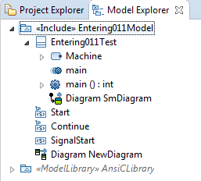
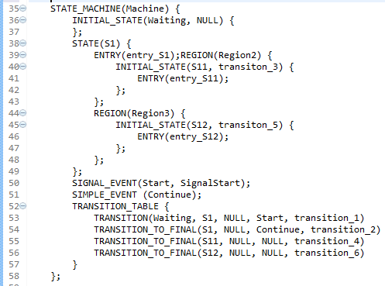
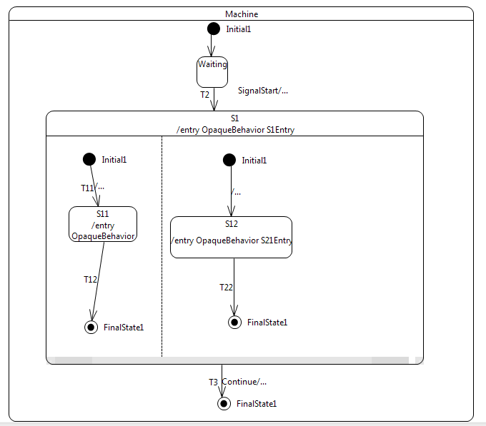
Round-trip engineering: Front-end 2: Connecting UML State Machine to C++
State machine description
This is defined inside of C++ class declaration (as a member of the C++ class), simplified version

Slide 19
Round-trip engineering: Front-end 2: Debugging
How to debug the system?
UML Model
UML Model
1a
Set breakpoint
Traceability
Use
Set breakpoint
To front-end
3b
Set breakpoint
To model
2a
1b
Set breakpoint
Front-end Code
Front-end Code
Traceability
Use
Set breakpoint
To back-end
Set breakpoint
To back-end
3a
2b
Back-end Code
Back-end Code

Slide 20
Round-trip engineering method
Reverse engineering
Front-end Code
SMDes
UML Model
Structure
Synchronizer
C++
Behavior

